Slide 1

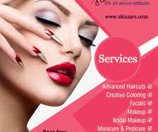
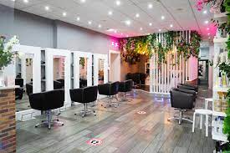
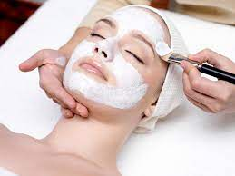

PROFESSIONAL GROOMING SYSTEM
SCT221-C004-0358/2016
MARY MUTISO

Slide 2
ABSTRACT
Many people experience a hard time in looking for trustworthy and experienced skilled experts in the grooming sector. The tendency is to ask around from neighbours,relatives or friends. The search for experts in this industry can be greatly improved by use technology including web and mobile.
This project aimed at developing a modern solution to address the difficulties faced by people with busy schedules while looking for assistance in their grooming services. An online professional grooming system will therefore be developed to meet this challenges. The web application offers both ease of booking the experts according to their well performed sectors and assures the clients of good services and close locations of the salons/spas, while also assuring them attendance at the time of their choice. The clients have a safe way of paying for services using e-money and they get to rate the services rendered to them.
The application is developed using HTML, CSS, JavaScript, JQuery, PHP and MySQL. User involvement is an integral part of this project, and it takes place throughout the lifecycle. The result is an application that is very interactive and incorporating a friendly user interface which makes it very easy for the clients to use for booking hence providing an overall acceptable platform for recommending experts in different areas within the salon organization.

Slide 3
INTRODUCTION
We are living in a period in which the whole globe spins on the concept of the World Wide Web. Ever since the internet came into being in the late 1990s, the world has slowly shrunk into smaller versions of the global village with communications being enhanced to be as simple as a simple finger-click away.
With such an advancement the rate of industrialization has also been taking on an automated direction with people rapidly exiting the comfort of their offices and opting for far more mobile means of completing the same tasks thanks to the mobile technology of computers which never seizes to evolve with every day that goes by.
Most salons nowadays have all these facilities in the same working space to enable the service providers to save on the rental charges of the place. With all these facilities in the same place, a new customer coming into the place may end up wasting a lot of time trying to know the best person to provide a specific service they are looking for. Not knowing the best person to sort the customer out, the customer may also end up with a service provider who is not very skilled and hence get poor services yet still must pay for the service.
Most customers looking for a new salon may go to far places looking for a service that could be somewhere around their residential area. The geographical aspect will be considered when creating the grooming system with service providers for the different sections and ratings for all professionals. The system will enable users to book sessions with the allocated service providers and after being attended to, they can also be able to pay for the service using the same system.

Slide 4
PROBLEM STATEMENT
In our daily lives, we are always encouraged to look decent for your personal hygiene and to have confidence among other people. In our county Kenya when one is looking for a job and especially white-collar jobs, for anyone to even think of employing you, they’ll look at how neat and sharp you look. Self-grooming is a lifestyle, but the part of the body exposed when you meet people for the first time is the head and face.
Many people have invested a lot to look neat and decent daily. Most of the grooming services are offered at different prices and everyone has their own area of expertise in the salon/kinyozi they work in. Some of these services include hair dressing, haircut, manicure and pedicure, makeup and beauty, massage services and the body treatment service. The services mentioned all have different persons with the quality professional skills.
In areas like the CBD, many people waste a lot of time trying to get the best services from service providers they have never met and in most cases, they end up not pleased with the services but still must pay for it. On the service providers side, many of them lose customers because of their busy schedule and the location they are based in.
The customers lose money to bad service and time for looking for a quality place not to mention they don’t have a platform to rate these service providers to help someone else who is in their current ordeal.

Slide 5
OBJECTIVES
General Objectives
Research on online grooming services and existing platforms.
Specific objectives
Creating a system that will enable users to login as either clients or workers.
A system that will enable clients to connect to users within a similar geographical to save on time and cost of services between both parties.
Creating a system that enables users to evaluate the workers prior to booking them for services.
Workers should be notified once they have been booked for service by the client.
Clients and clients should be able to keep track of the services they received.

Slide 6
BUDGET
ITEM | QUANTITY | COST | TOTAL
Laptop | 1 | 45000 | 45000
Windows 10 | 2 | 20000 | 40000
Wamp server/ Internet browser | 1 | 2500 | 2500
Antivirus | 1 | 2000 | 2000
Backup drive | 1 | 2000 | 2000
Flash disk | 1 | 1000 | 1000
Transport | - | 700 | 700
Internet browsing | - | 1000 | 1000
Printer | 1 | 8000 | 8000
TOTAL | - | 54010 | 101,200

Slide 7
PROJECT SCHEDULE
WEEKS | 2 | 4 | 6 | 8 | 10 | 12 | 14 | 16 | 18 | 20 | 22 | 24 | 26 | 28
ACTIVITY
PROJECT PROPOSAL
FEASIBILITY STUDY
DESIGN
CODING
TESTSING
IMPLEMENTATION
DOCUMENTATION
PRESENTATION

Slide 8
LITERATURE REVIEW
Automation of the grooming system effectiveness is that it helps the manager, employees, and customers to make it easier and become more successful. These are the advantages of automated grooming system; first in terms of speed, they can process information more quickly than humans. This means they are good for controlling machinery that might need to be adjusted instantly. Second is repetition, automated systems can do the same task repeatedly without getting bored, needing breaks, or making mistakes. Third is accuracy, they can do incredibly detailed work and follow precise instructions without error. Fourth is safety, automated systems can work in places where it would be unsafe to put a human, for example, in a nuclear power plant, under water or in space. Fifth is efficiency, they get more done than humans but cost less to run. This is because they do need breaks, wages, holidays, canteens, heating, and lighting. The quality of the work done is always of the same standard being materials are not wasted due to human error. Sixth is adaptability, automated systems can be reprogrammed to do different tasks.

Slide 9
LITERATURE REVIEW CONT
RELATED STUDIES
What to Consider when Deciding on the Right Salon Software for Your Salon or Spa
Supported Countries.
Flexibility vs. Simplicity.
Integrations.
Design.
Price.
Features & Functionality

Slide 10
LITERATURE REVIEW CONT
GAPS BRIDGED BY THE STUDY
Salons and spas have been using manual booking system of booking sessions and recording transactions. The researchers used the descriptive method of research to collect information to the respondents about the current booking system. Having a computerized or electronic grooming system gives an advantage to the owner of the salon than to stick to the current manual system where customers call to book sessions. It takes too much time to record the customer’s data and other transactions. In manual booking system the security of the records is low. This study aims to supply the staffs, managers and especially the owner of Spa/salon. This will lead to the improvement of the current system they are using and for the advancement of the establishment. Spas must have a better and effective system for keeping and retrieving of their records. It will contribute to the success of the business and to gain the trust of their customers.

Slide 11
LITERATURE REVIEW CONT
Advantages of Grooming System
Business Automation
Automatic Creation of a Centralized Database
Business Mobility
Cash Management
Business Personalization
Employee Management

Slide 12
RESEARCH METHODOLOGY
Qualitative research is defined as a market research method that focuses on obtaining data through open-ended and conversational communication. This method is not only about “what” people think but also “why” they think so. For example, consider a convenience store looking to improve its patronage. A systematic observation concludes that the number of men visiting this store are more. One good method to determine why women were not visiting the store is to conduct an in-depth interview of potential customers in the category. Common approaches include grounded theory, ethnography, action research, phenomenological research, and narrative research. They share some similarities but emphasize different aims and perspectives.
Quantitative research is a systematic investigation of phenomena by gathering quantifiable data and performing statistical, mathematical, or computational techniques. Quantitative research collects information from existing and potential customers using sampling methods and sending out online surveys, online polls, questionnaires, etc., the results of which can be depicted in the form of numerical. After careful understanding of these numbers to predict the future of a product or service and make changes accordingly. Quantitative research is widely used in the natural and social sciences: biology, chemistry, psychology, economics, sociology, marketing, etc.
Combine qualitative and quantitative data : Using a combination of qualitative and quantitative data can improve an evaluation by ensuring that the limitations of one type of data are balanced by the strengths of another. This will ensure that understanding is improved by integrating different ways of knowing. Most evaluations will collect both quantitative data (numbers) and qualitative data (text, images); however, it is important to plan how these will be combined.

Slide 13
RESEARCH INSTRUMENTS
Based on the system to be created, the following techniques were used in creating the system.
1. Interviews
In this instance interviews were carried with a few salon owners and regular customers as key respondents in order to identify the type of services they require and how the experts got and handled the new clients. This also enabled the evaluation of the payments received by each saloonist on a daily basis i.e. when they are presented with a new job .
2. Review of existing systems
The existing such as www.ashleyskenya.com were also visited to determine how they operated and identify the major points of weakness as described by the users during the interviews. This also enabled the acquisition of first-hand experience when it came to acquiring opinion on the system.
3. Online reviews by other sites
Reviews by other sites who are major stake holders in the market were also taken into consideration as they gave a better outlook of the system due to experience in the current market and the vast nature of their comparison with even more precision involved.

Slide 14
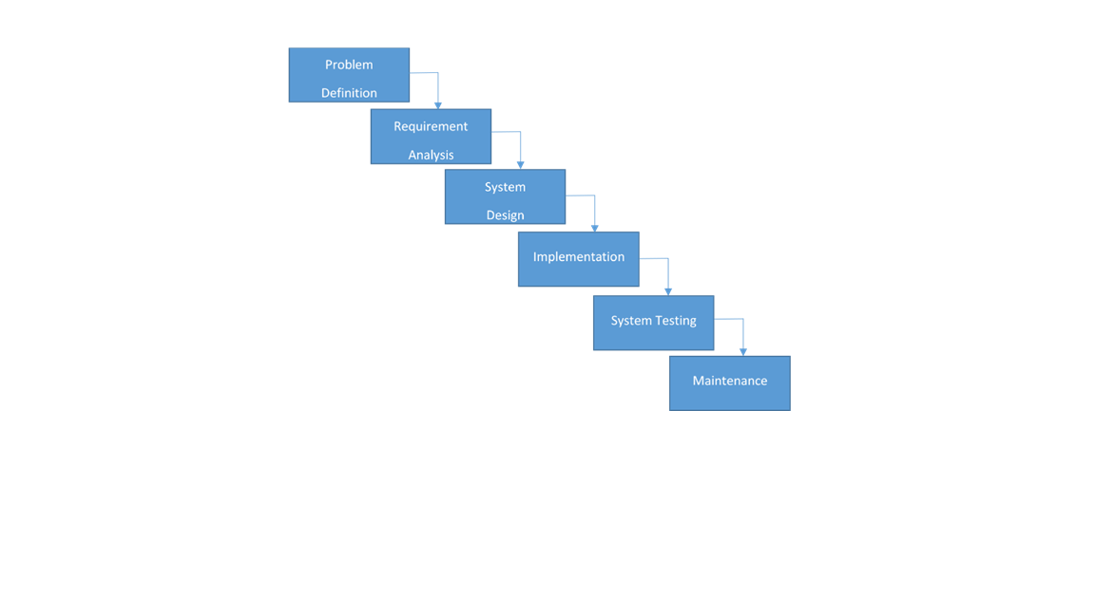
SYSTEM DEVELOPMENT METHODOLOGY
The system development method used is waterfall method.

Slide 15
FEASIBILITY STUDY
FEASIBILITY STUDY: Feasibility is the process of measuring how the development of the proposed system will be beneficial or practical to the target group or users.
Operational Feasibility : It is the measure of how well the solution will work and of how people feel about the proposed system. The process of acquiring a saloonist by a client is usually a tiring one if the given client does not have the knowledge professional salon organizations. Similarly, the process of acquiring a new client by a saloonist individually will be equally as straining. The proposed system should enable ease this situation by creating an environment where this two groups of individuals get to interact in a seamless manner.
Technical Feasibility It is the measure of the practicality of the proposed system about availability of technical resources and expertise. The proposed system is a web based and uses emailing technology for communication between the system (organization), the clients and the salon experts. To achieve all these existing web-based technologies that are free to acquire and used will be utilized. These technologies and resources include HTML, CSS, JavaScript, PHP and MYSQL as the scripting languages which will be used alongside software resources that include PHP-Storm editor, WAMP-Server local web hosting software and Google Chrome browser as the testing environment for the website during development.
Schedule Feasibility :This is the measure of how reasonable the timeline for the proposed system is. Twelve weeks is adequate to build the web application and mobile application to completion. This is as there exists the technical expertise required for building the system.
Economic Feasibility : This is the measure of the cost-effectiveness of the proposed system in terms of building the system and the returns after the system is complete and functional. The proposed system will be made by software tools which are open source hence free, and this makes the system building cost to be almost negligible. No further personnel services will be required during the development of the system making the whole process easy to carry out to completion without any further constrains.

Slide 16
Requirement Specifications
Requirement Specifications
At this stage, knowledge about the existing systems from the interviews and reviews of the existing systems will be used. This will define their demerits and any other extra information that the users would like included in the proposed system.
Functional requirements
The system should be able to meet the following functional requirements:
Give users the ability to create accounts based on their interests i.e., clients or salon experts
The system should allow clients to request for services
Allow the salon experts to post the services which they offer on the website
The system should enable the notification of the experts once there is a new client for them to attend to.
The system should enable the clients to make payments for their service and enable the payment of the experts upon the completion of each task.
The system should enable the cancellation of client bookings by both the experts and the clients of need arises.
The system should enable the clients to be refunded in the instance of job cancellation unavailability of the experts on the said date of the delivery of the client booking.
viii. The system should enable the clients to keep track of all the services that they received and for the experts to also keep track of the clients that they have served.
Non-Functional Requirements
The system should be able to meet the following non-functional requirements:
Usability: The system should have a user interface that is easily usable by the clients.
Security: The system should not allow the clients to be able to access data in the system without registering first.
Reliability: The system should be accessible at any given time.
Accuracy: The system should be able to send emails to the specific client and workers and allow emails to also be sent to the organization for communication purposes.

Slide 17
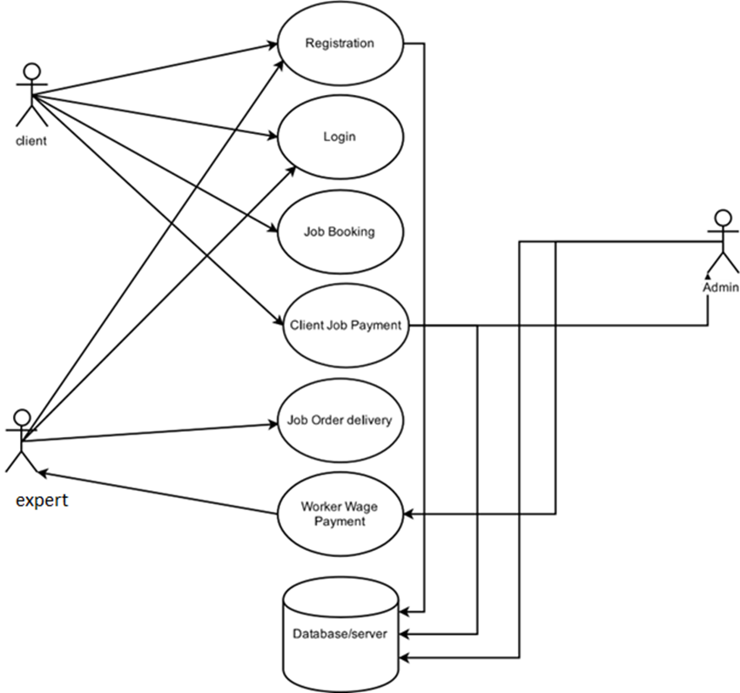
USE CASE DIAGRAM

Slide 18
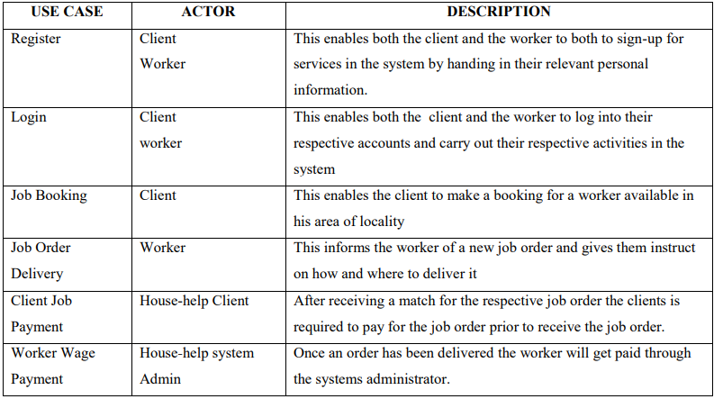
USE CASE DIAGRAM CONT…

Slide 19
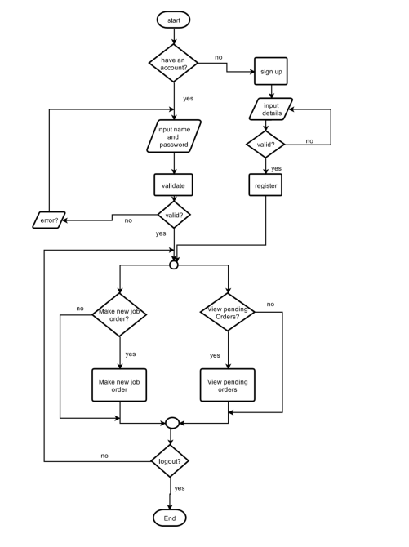
DFD CLIENT CHART

Slide 20
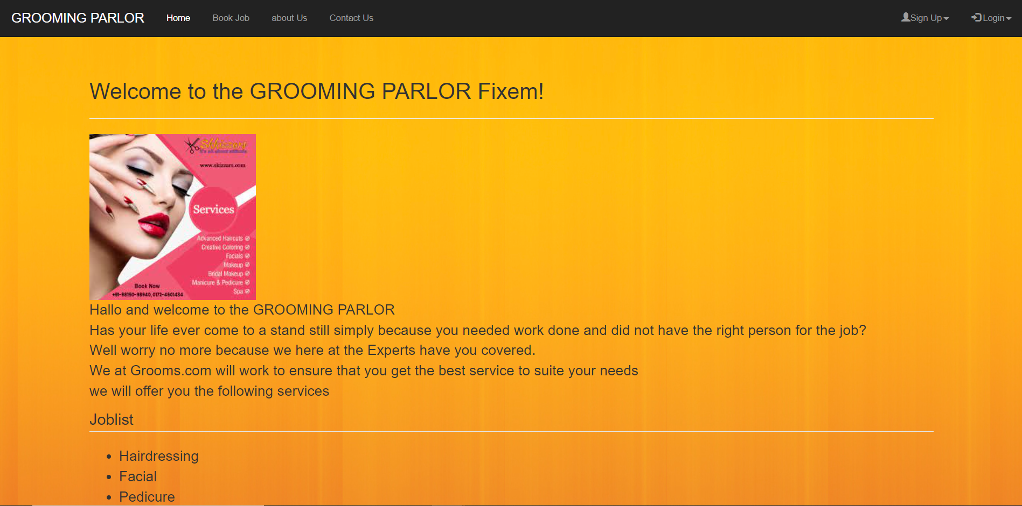
SYSTEM APPLICATION DESIGN
Homepage

Slide 21
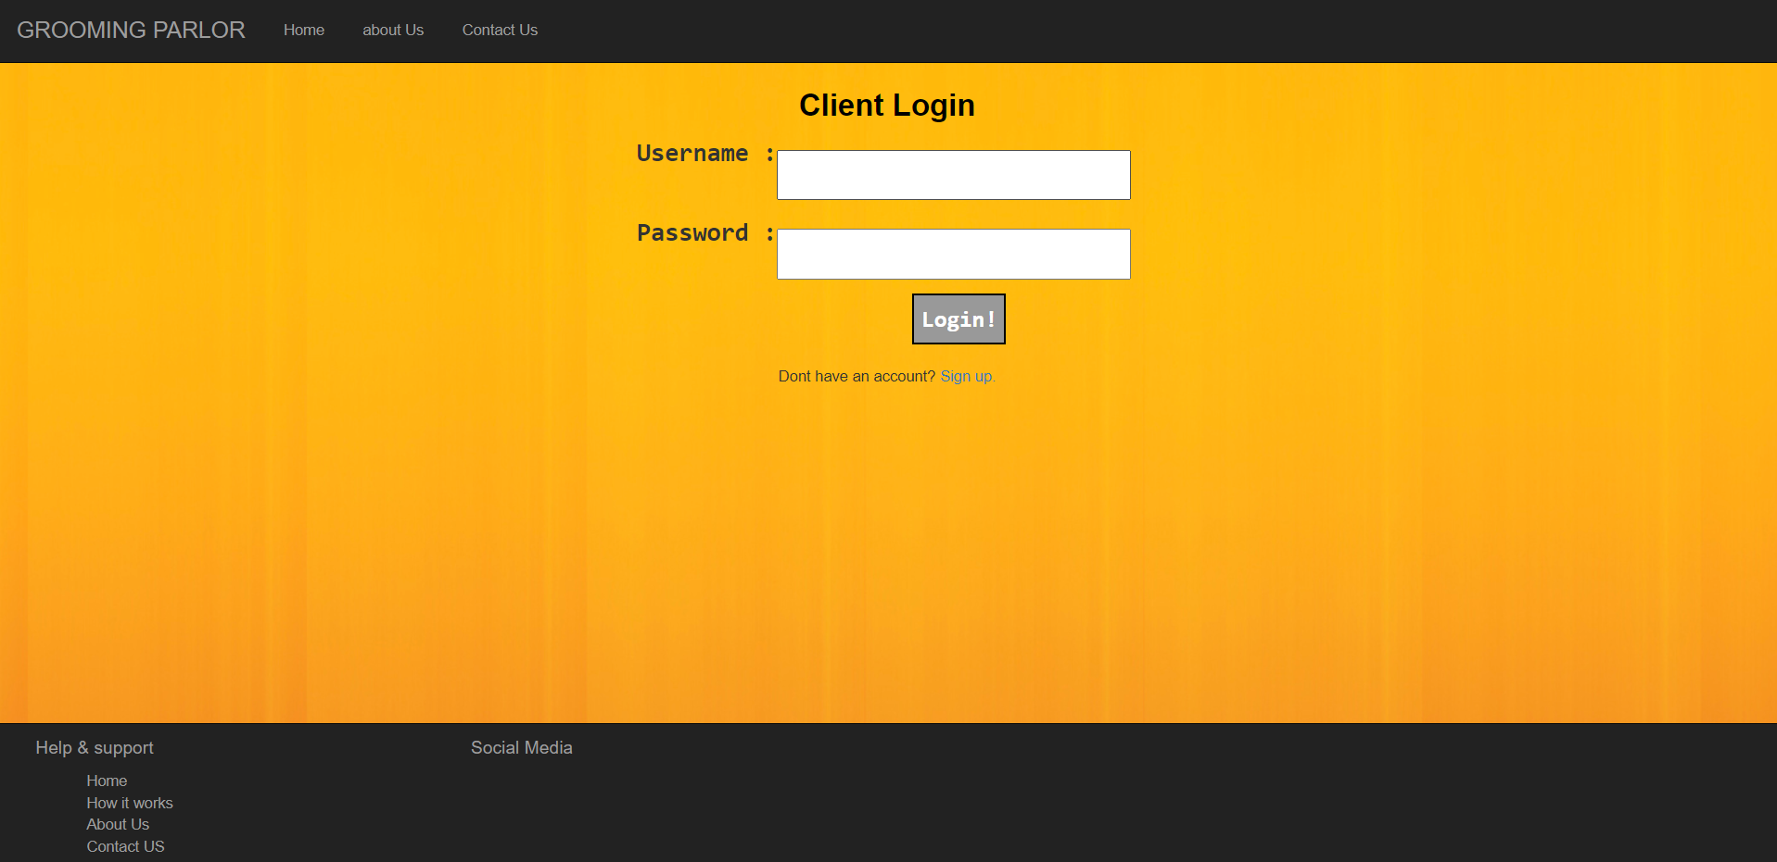
SYSTEM APPLICATION DESIGN
User Login

Slide 22
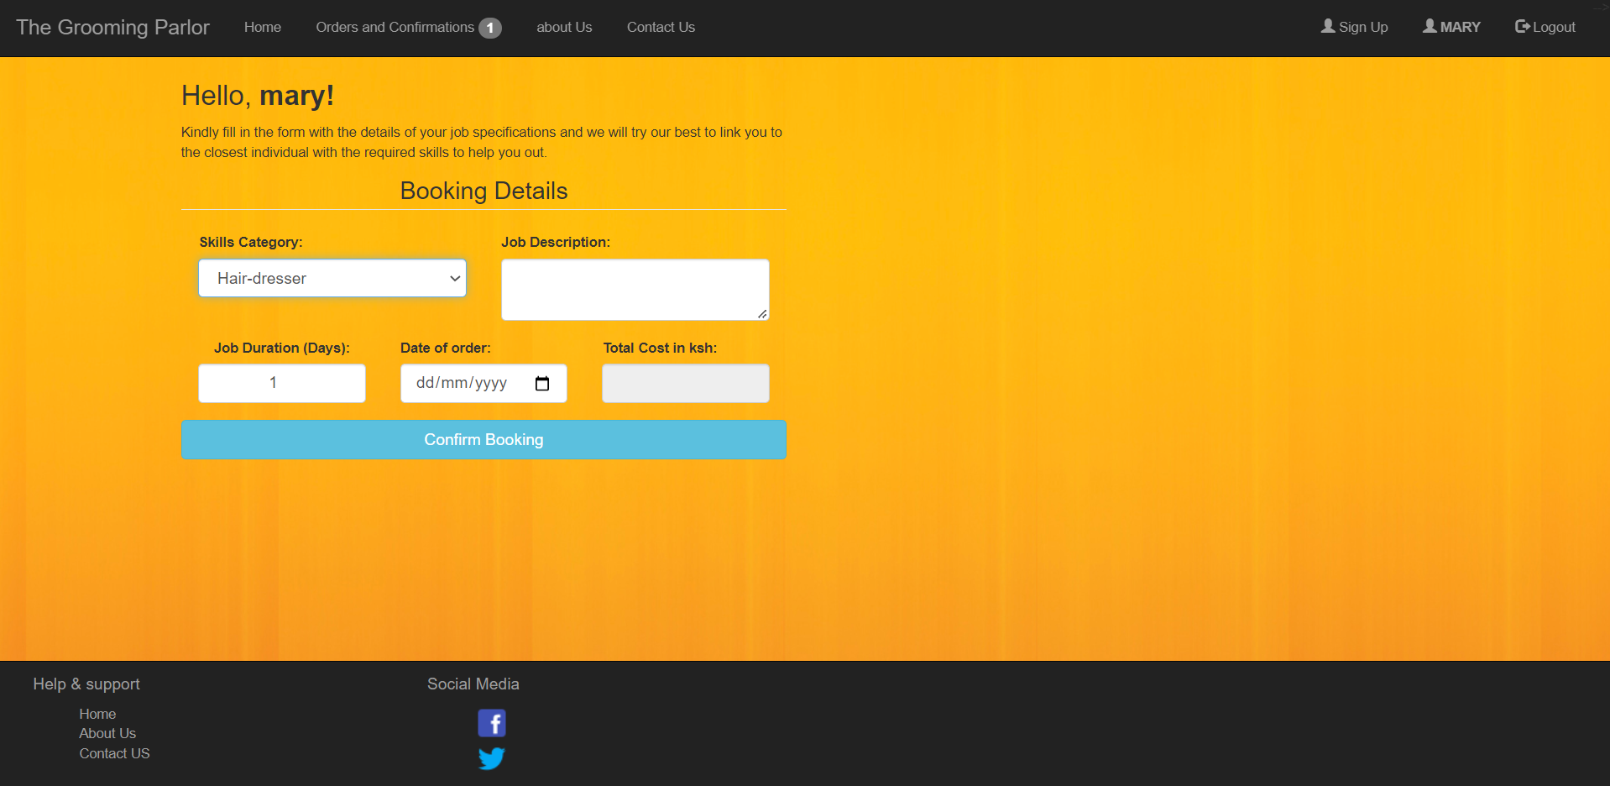
SYSTEM APPLICATION DESIGN
Client Booking

Slide 23
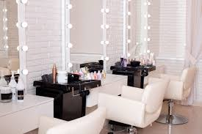
THANK YOU
MARY MUTISO
SCT221-C004-0358/2016

